Slide 1
Cosmos DB Fundamentals

Slide 2

Jes Borland Software Engineer @ Microsoft jes.borland@microsoft.com @grrl_geek LessThanDot.com

Slide 3
Cosmos DB isn’t another SQL Server flavor in “the cloud”!
Cosmos DB is for NoSQL data
Not relational, not highly structured
This one data store has a common model for multiple types of data structures

Slide 4
What kind of data can be stored?
Document (SQL)
Document (MongoDB)
Table (Key/Value)
Wide column (Cassandra)
Graph (Gremlin)
Etcd (Key/Value)

Slide 5

Benefits of Cosmos DB
Globally distributed
Offers varying levels of throughput
Offers multiple consistency models
Has performance SLAs
Performs automatic indexing
Fully managed Azure fabric

Slide 6
APIs

Slide 7
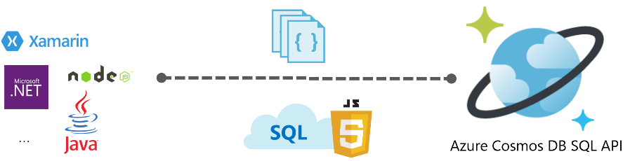
SQL
The SQL API started life as DocumentDB - a JSON database engine with a query language that will look familiar to those used to T-SQL

Slide 8
SQL API Use Cases
Anything that generates JSON data!
IOT
Retail
Gaming

Slide 9
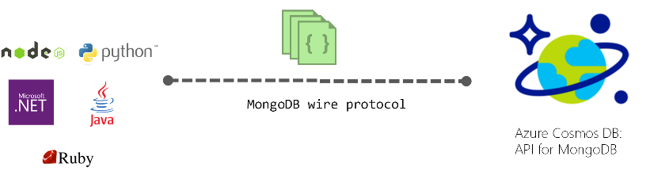
MongoDB
Mongo is an open-source document database which uses JSON-like documents
Existing Mongo databases can have data imported directly, then the applications that use them can be pointed to Cosmos DB
Existing tools like Mongo Shell can be used with Cosmos DB

Slide 10
MongoDB API Use Cases
Content Management Systems (CMS)
Timekeeping
IOT

Slide 11

Table
The Table API directly interacts with Azure Table Storage, which is key/value pairs
Gives additional features that Storage alone can't such as global distribution, higher throughput

Slide 12
Table API Use Cases
Replace Redis (an application caching program)
Games and scores per player
Shopping carts
Analytics materialized view for specific dates

Slide 13
Etcd
In Kubernetes, etcd is used to store the state and the configuration of the Kubernetes clusters.
Ensuring availability, reliability, and performance of etcd is crucial to the overall cluster health, scalability, elasticity availability, and performance of a Kubernetes cluster.

Slide 14

Cassandra
Apache Cassandra is a distributed, wide column store database
“Wide column store” has tables with rows and columns, but names and format of columns vary from row to row in the same table
Developed at Facebook to power the inbox search feature

Slide 15
Cassandra API Use Cases
Systems where writes exceed reads
Transaction logging
Package tracking
IoT

Slide 16
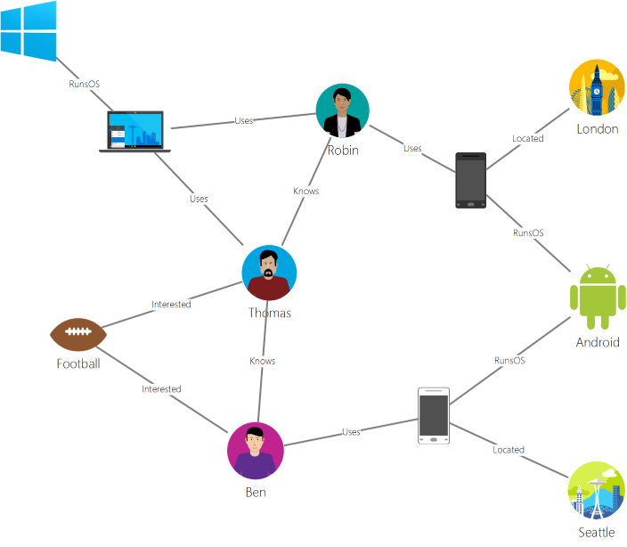
Graph
Graph is a non-relational data store that lets you define entities (vertices), and the relationships between them (edges)
Uses the Apache TinkerPop language "Gremlin"
It's very different from SQL!

Slide 17
Graph API Use Cases
Social networks
Vertices - people
Edges - relationships
Recommendations
Vertices - restaurant, location, cuisine type
Edges - cuisine type, distance to specific location
Logistics
Vertices - airports
Edges - flights

Slide 18
Cosmos DB Infrastructure

Slide 19
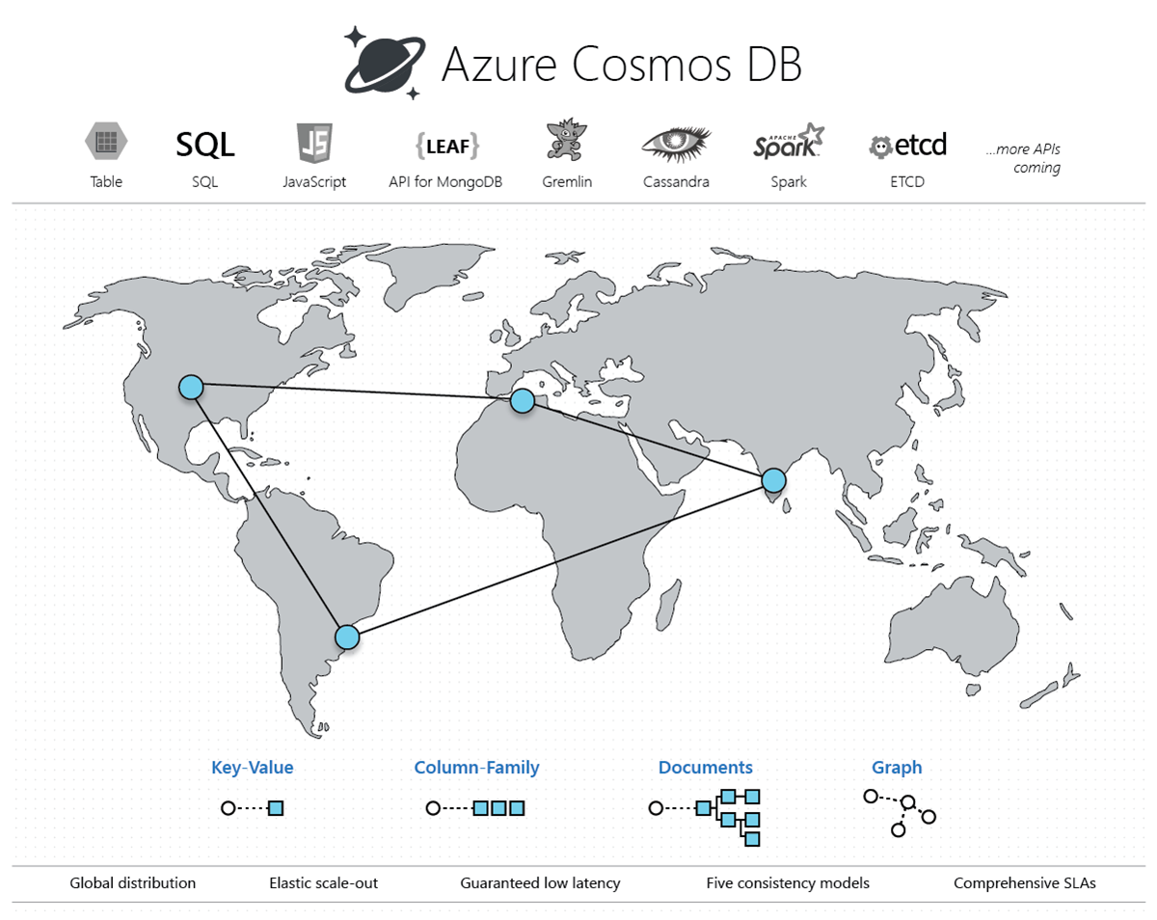

Slide 20
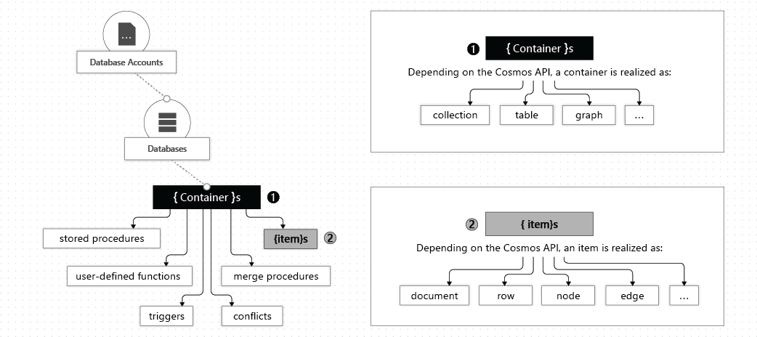
Resource Model
Notes:
API is set at Database level. Can’t change.
Move data between collections? In the same database, with API or Cosmos DB Data Migration Tool.

Slide 21
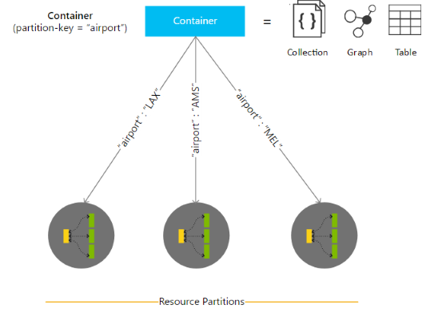
Horizontal Partitioning
Partitioning maps data to physical storage
You choose a logical partitioning key
Choose wisely
The partition key will determine how data is returned when you query it later
Notes:
Partitions & partition key. Partition is per container.
Cosmos picks the # of partitions
IOT example: partition key is device id because in the end, will want to query by device, so you want everything to be together
Rus are greatly affected by partitions
Rus are evenly split per partition
Partitioning in Azure Cosmos DB - https://docs.microsoft.com/en-us/azure/cosmos-db/partitioning-overview#choose-partitionkey

Slide 22
Partition guidance and performance
Queries that access data in a single logical partition are more cost-effective than queries that access multiple.
Transactions are allowed only against a single logical partition.
The best choice is something with high cardinality
What is high cardinality? More uniqueness.
Binary is low cardinality - true/false
Unique ID is high cardinality
First name may be somewhere between

Slide 23
Partitioning questions
Can I change the partitioning key?
No. You would have to create a new collection with the new partition key, and move the data.

Slide 24
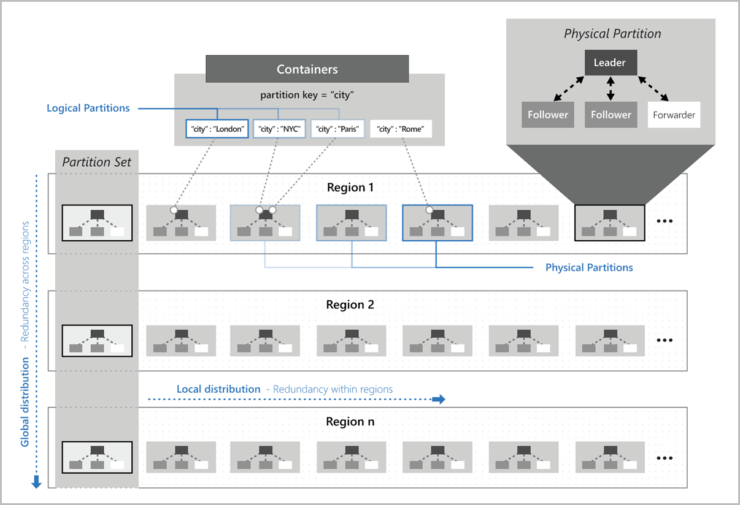
Notes:
How logical partitions are mapped to physical partitions

Slide 25
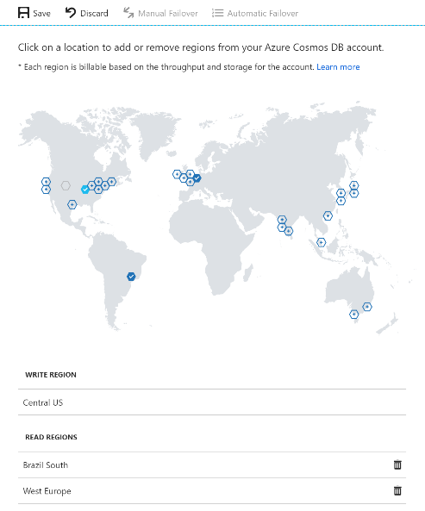
Global Distribution
Global distribution is how the data is replicated to the regions you choose
You can choose automatic or manual failover between regions
This can be set in the Azure Portal, or in the application's ConnectionPolicy parameter

Slide 26
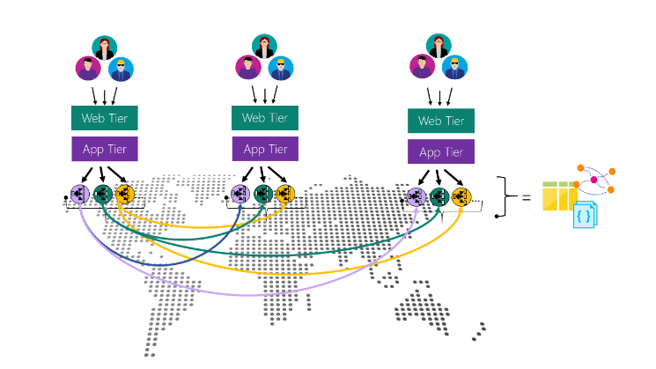
Multi-master writes
Write-anywhere model
< 10 ms latency and 99.999 % write availability
Notes:
Conflict resolution https://docs.microsoft.com/en-us/azure/cosmos-db/conflict-resolution-policies
Last Write Wins, Custom.
Change in app code - https://docs.microsoft.com/en-us/azure/cosmos-db/how-to-manage-conflicts

Slide 27
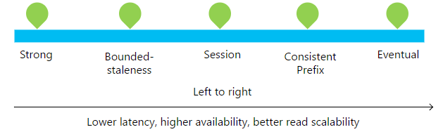
Consistency Levels
SQL Server has isolation levels
Read Uncommitted
Read Committed
Repeatable Read
Snapshot
Serializable
Cosmos DB has consistency levels
Eventual
Consistent prefix
Session
Bounded stateless
Strong
Notes:
Set with CLI, PowerShell, Portal
Consistency can be changed per request in app code.
https://docs.microsoft.com/en-us/azure/cosmos-db/how-to-manage-consistency#configure-the-default-consistency-level

Slide 28
Strong
A write is only visible after it's committed to a majority quorum of replicas
Reads are guaranteed to return the most recent version
Can only be used in one region
Examples
Banking accounts
Payment processing
Reservation systems
“Absolute truth every time”

Slide 29
Bounded stateless
Reads can lag behind writes in a "staleness windows"
K versions
t time interval
Global total order outside of that window
Recommended for globally-distributed applications
Examples
Flight status app
Package tracking app
“Not too old”

Slide 30
Session
Consistency is scoped to a single session
Guarantees RYW - read your own writes
Examples
Social profile updates
Retail shopping cart
Social music app preferences
“Logical, real-time experiences for a user”

Slide 31
Constant Prefix
If there are no more writes, all replicas will have the same data
….and in the correct order
Examples
Baseball score updates
Social media comments
“The order of the data tells as much of a story as the end result”

Slide 32
App writes:
Jes
Erin
Sarah
Client 1 sees:
Jes
Erin
Client 2 sees:
Jes
Client 3 sees:
Jes
Erin
Sarah

Slide 33
Eventual
Eventually, with no further writes, all replicas in a group eventually converge
A session may get values older than what it saw on a previous read
Examples
Product reviews
Social media following posts
Receipts
“Apps that live and die according to their availability”

Slide 34
Throughput
Request Units
CPU + memory + IOPs
Similar to a SQL Database DTU
A 1-RU throughput corresponds to the throughput of the GET of a 1-KB document
Each operation (create, update, delete, read, query) requires X RUs for each consistency level
CRUD are consistent
SELECT returning X rows - these depend on X
The query explorer in the Portal will show you how many RUs a query used

Slide 35
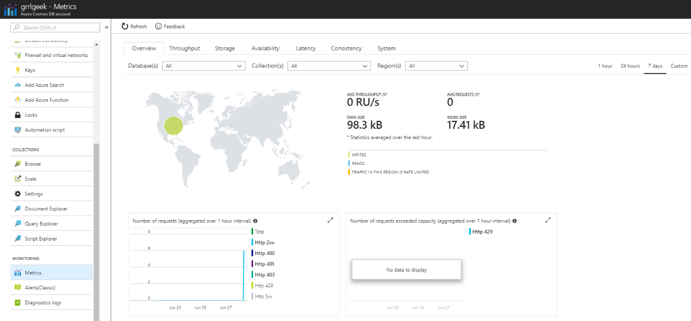
Viewing Metrics

Slide 36
Working with Cosmos DB

Slide 37
I'm the DBA...hold me, I'm scared
High Availability
All writes are durably committed to local disks by a quorum of replicas within a local data center before acknowledging to the client
Each partition is made highly available via a replica set
Disaster Recovery
Choose multiple regions for DR

Slide 38
Backup and restore
Backups
Full backups taken approximately every 4 hours
The last 2 backups are stored at all times in Azure Blob storage
Stored in same region as your current write region
Replicated to another region via GRS
"If the data is accidentally dropped or corrupted, contact Azure support within eight hours."
Restores
File a support ticket or call Azure support

Slide 39
Security
Policy-driven IP-based access controls for inbound firewall support
Using the master key for the account, you can create user resources and permission resources per database
Data is encrypted at rest
All client-to-service Azure Cosmos DB interactions are SSL/TLS 1.2 capable. All intra datacenter and cross datacenter replication is SSL/TLS 1.2 enforced.
Notes:
https://docs.microsoft.com/en-us/azure/cosmos-db/database-security
Firewall - https://docs.microsoft.com/en-us/azure/cosmos-db/firewall-support
Master Key - https://docs.microsoft.com/en-us/azure/cosmos-db/secure-access-to-data
Encryption - https://docs.microsoft.com/en-us/azure/cosmos-db/database-encryption-at-rest

Slide 40
I'm the developer...hold me back!
Quickstarts are available for all APIs in multiple languages
SQL
.NET
Java
Node.js
Python
Xamarin
MongoDB
Node.js
.NET
Java
Golang
Python
Graph
.NET
Gremlin console
Java
Node.js
Python
Table
PHP
.NET
Java
Node.js
Python

Slide 41
Let's play
Azure Cosmos DB Emulator https://docs.microsoft.com/en-us/azure/cosmos-db/local-emulator
Quickstart: SQL API + .NET https://docs.microsoft.com/en-us/azure/cosmos-db/create-sql-api-dotnet

Slide 42
Demo
Open Azure Cosmos DB Emulator
Open Visual Studio
Emulator – click Explorer, click New Collection
Database id – Create new – Tasks
Collection id – Items
Storage – Fixed
Throughput – 400
OK

Slide 43
Demo 2
Click Items > Documents > New Document
{
"id": "1",
"category": "personal",
"name": "groceries",
"description": "Pick up apples and strawberries.",
"isComplete": false
}
Save
New
{
"id": "2",
"category": "workout",
"name": "spin",
"description": "12:10 spin class",
"isComplete": false
}
One more, category “personal”

Slide 44
Demo 3
Click Edit Filter button.
Add ORDER BY c._ts DESC
Click New SQL Query
SELECT * FROM c WHERE c.category = "workout"

Slide 45
Demo 4
Visual Studio > Open Project/Solution > C:\git-samples\documentdb-dotnet-todo-app > todo.sln
Open web.config
<add key="endpoint“ – add URI
<add key="authKey“ – add Primary Key
<add key="database" – add Database name Tasks
<add key="collection“ – add Collection name Items
Run app – F5 or green arrow with “Microsoft Edge”
Click Create New
Baking
Make zucchini bread
Personal
Create

Slide 46
Demo 5
Emulator > Explorer > New SQL Query
SELECT c.id, c.name, c.description, c.isComplete FROM c WHERE c.category = "personal"
Close Edge
Stop program
Close VS
Close Emulator

Slide 47
Why Cosmos DB?
Distributed worldwide
Scalable up/down for surges and dips in usage
Flexible with consistency models
Meets or exceeds performance SLAs
Notes:
What problems does it solve?
Applications need a back end data store that is:
Distributed worldwide
Scalable up/down for surges and dips in usage
Flexible with consistency models
Meets or exceeds performance SLAs

Slide 48
Resources
Azure Cosmos DB product page - https://azure.microsoft.com/en-us/services/cosmos-db/
Documentation - https://docs.microsoft.com/en-us/azure/cosmos-db/
eBook - https://discover.microsoft.com/apps-for-cats/ (Highly recommended, less than half an hour to go through.)
SLAs https://azure.microsoft.com/en-us/support/legal/sla/cosmos-db/v1_2/

Slide 49
Questions?

Slide 50
Jes Borland Premier Field Engineer Microsoft jes.borland@microsoft.com @grrl_geek LessThanDot.com

